Slide 1
Agile Processes Unit-2

Slide 2
Agenda:
Lean Production
Scrum
Crystal
Feature Driven Development
Adaptive Software Development
Extreme Programming:
Method Overview
Life Cycle
Work Products
Roles and Practices

Slide 3
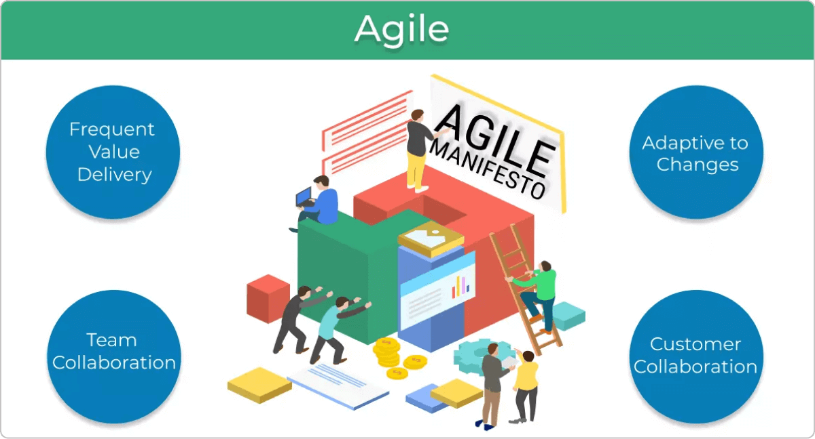
AGILE PROCESSES:
Focus on flexibility, teamwork, and efficiency.
Help teams adapt quickly to changes.
These processes are Based on the Agile Manifesto.
Commonly used in software development.

Slide 4

LEAN PRODUCTION:
Lean Production focuses on reducing waste
and improving efficiency.
It comes from the Toyota Production System (TPS).
The goal is to optimize resources
and minimize costs.
Lean ensures high quality by removing unnecessary steps.
Waste in production is called "Muda" in Japanese.
Lean principles are used in manufacturing, services, and software.
It helps improve processes and create more value.

Slide 5
LEAN PRODUCTION

Slide 6
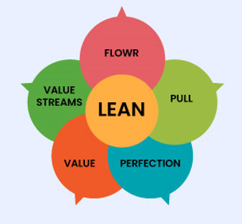
Core Principles of Lean Production:
Identify Value – Understand what the customer
values and focus on delivering it.
Map the Value Stream – Analyze the production
process to eliminate waste and improve efficiency.
Create Flow – Ensure a smooth and continuous
workflow without delays or bottlenecks.
Establish Pull – Produce only what is needed,
when it is needed, to avoid overproduction.
Seek Perfection – Continuously improve
processes to enhance quality and efficiency.

Slide 7
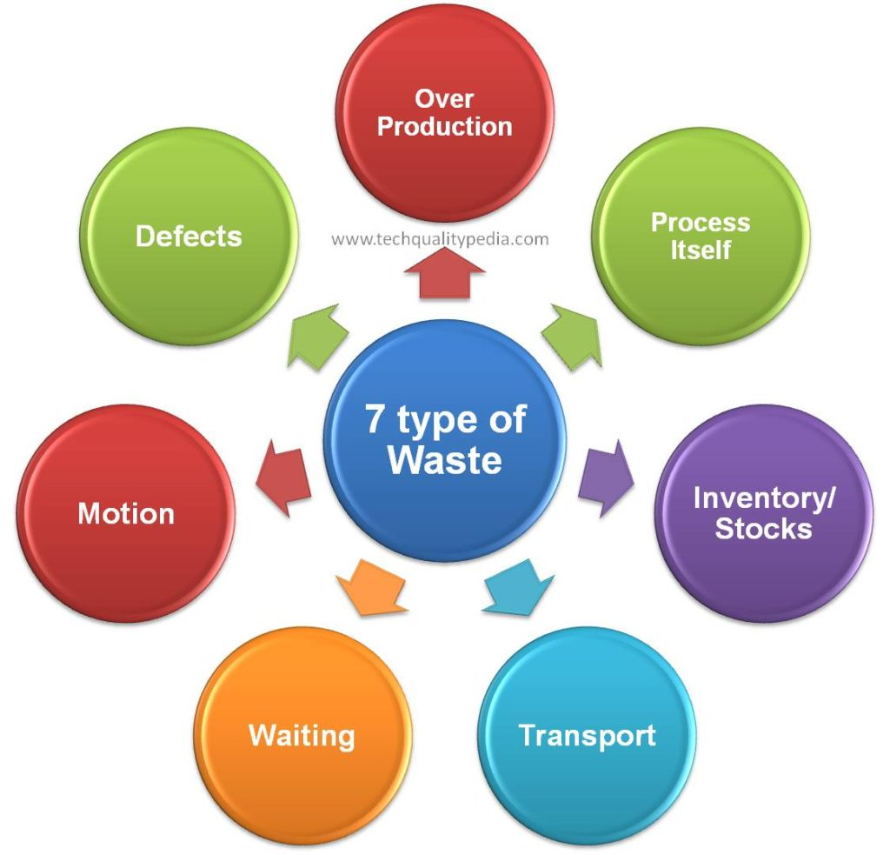
Types of Waste in Lean Production (The 7 Wastes):

Slide 8
Overproduction – Producing more than what is needed, leading to excess inventory.
Waiting – Idle time due to delays in production or decision-making.
Transport – Unnecessary movement of materials, increasing costs and risks.
Overprocessing – Doing more work than required, such as using higher-quality materials than needed.
Inventory – Excess raw materials, work-in-progress, or finished goods that increase storage costs.
Motion – Unnecessary movement of people, leading to wasted time and effort.
Defects – Errors or rework that increase costs and reduce quality.

Slide 9
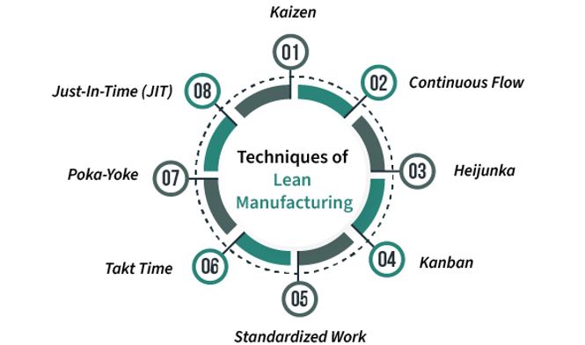
Tools and Techniques Used in Lean Production:
1. 5S (Workplace Organization)
Sort – Remove unnecessary items.
Set in Order – Organize tools and materials.
Shine – Keep the workplace clean.
Standardize – Create consistent procedures.
Sustain – Maintain and improve continuously.
2. Kaizen (Continuous Improvement)
Small, regular improvements by all employees.
Encourages teamwork and innovation.

Slide 10
3. Kanban (Visual Workflow Management)
Uses visual signals to manage workflow.
Helps track inventory and production needs.
4. Just-in-Time (JIT) Production
Produces only what is needed, when needed.
Reduces inventory and storage costs.
5. Poka-Yoke (Error-Proofing)
Prevents mistakes in the production process.
Ensures quality control at every step.
6. Value Stream Mapping (VSM)
Visualizes the production process.
Identifies waste and areas for improvement.

Slide 11
7. SMED (Quick Changeover)
Reduces setup time for machines.
Increases production efficiency.
8. Andon (Problem Alert System)
Visual signals to highlight issues.
Helps fix problems quickly.
9. Cellular Manufacturing
Groups workstations for a smooth workflow.
Reduces movement and eliminates delays.

Slide 12
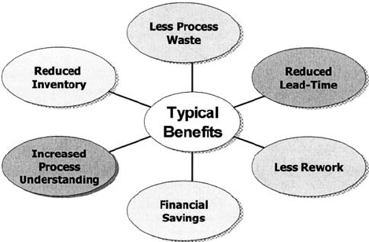
Benefits of Lean Production:
Reduced Costs – Cuts waste, lowers inventory,
and improves efficiency to save money.
Improved Quality – Focuses on quality at every stage,
reducing defects and increasing customer satisfaction.
Faster Delivery – Ensures quick production and
on-time delivery to meet customer needs.
Greater Flexibility – Adapts easily to changes in
demand and production requirements.
Employee Engagement – Encourages workers to share ideas and improve processes.

Slide 13
Challenges of Lean Production:
Difficult Implementation – Requires changes in culture, processes, and workspace.
Resistance to Change – Employees and managers may hesitate to adopt new methods.
Sustaining Improvements – Needs continuous effort to prevent slipping back into old habits.
Conclusion
Lean focuses on reducing waste and improving efficiency.
Helps businesses deliver better products at lower costs.
Continuous improvement is key to long-term success.

Slide 14
SCRUM

Slide 15
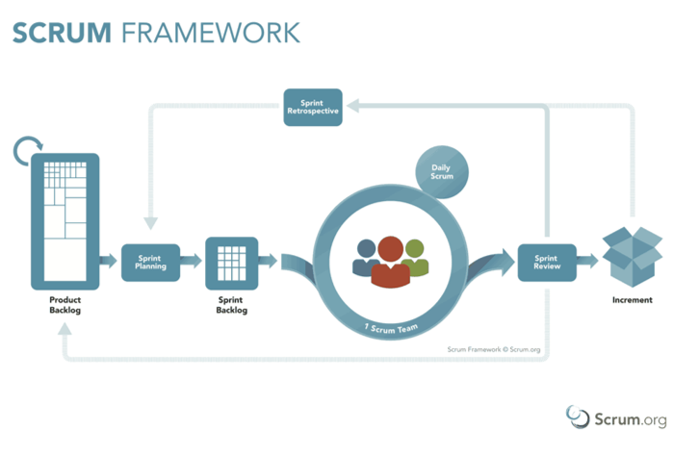
What is Scrum:
Agile Framework – Scrum helps teams work efficiently,
adapt quickly, and deliver quality results.
Time-Boxed Sprints – Work is divided into short
cycles (2-4 weeks) to create small, usable product updates.
Incremental Progress – Teams build and improve
products step by step, based on feedback.
Continuous Improvement – After each Sprint,
teams reflect and improve their process.
Scrum = Fast, Flexible, and Focused on Value.

Slide 16
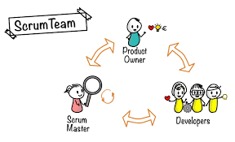
Key Roles in Scrum:
Product Owner:
What They Do?
Decides what to build and in what order
Manages & prioritizes the Product Backlog
Acts as a bridge between the team
and stakeholders
Key Duties:
✅ Define and prioritize work ✅ Ensure tasks bring the most value ✅ Communicate with stakeholders

Slide 17
Scrum Master:
What They Do?
Ensures the team follows Scrum rules
Removes roadblocks slowing the team down
Helps the team improve and stay focused
Key Duties:
✅ Facilitate Scrum meetings ✅ Protect the team from distractions ✅ Support continuous improvement

Slide 18
Development Team:
What They Do?
Builds the product in small steps
Works together to complete Sprint tasks
Delivers a shippable product every Sprint.
Key Duties:
✅ Collaborate & complete Sprint tasks ✅ Clarify requirements with the Product Owner ✅ Deliver a working product increment

Slide 19
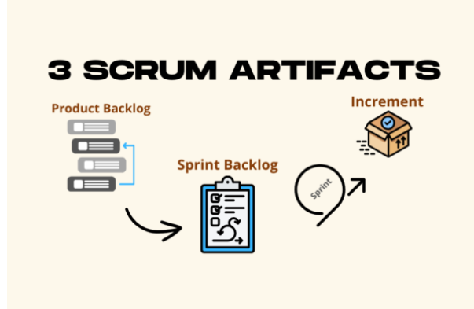
Scrum Artifacts:
Artifacts are the key outputs of Scrum, providing transparency and focus for the team and stakeholders
1. Product Backlog:
Its list of all tasks, features, Improvements.
Managed & prioritized by the Product Owner
2. Sprint Backlog:
A list of tasks the team commits to in a Sprint.
Its created in Sprint Planning
3. Increment:
The completed work that is potentially shippable.
Completed work can be released to customers or stakeholders.

Slide 20
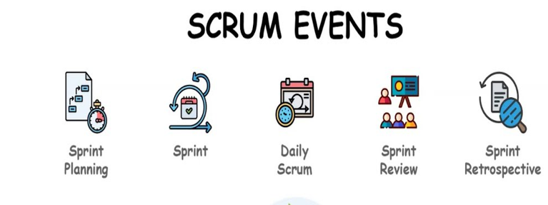
Scrum Events (Ceremonies):
communication throughout the project.
Events:
Sprint: A Sprint is a fixed period of time that cannot be extended.
and it starts with a Sprint Planning meeting and ends with a
Sprint Review and Sprint Retrospective.
2. Sprint Planning: A meeting where the Scrum team
(Product Owner, Scrum Master, and Development Team)
decides what to work on during the upcoming Sprint.
3. Daily Scrum (Daily Standup): A short (usually 15-minute)
daily meeting, will discuss about what completed yesterday and what need to do today.
4. Sprint Review: The team and stakeholders also discuss progress, any changes in the product backlog, and future priorities.
5. Sprint Retrospective: The goal is continuous improvement, and action items from this meeting should be implemented in future Sprints to improve team effectiveness.

Slide 21
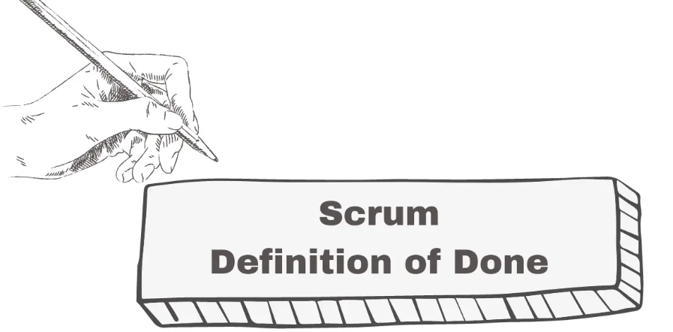
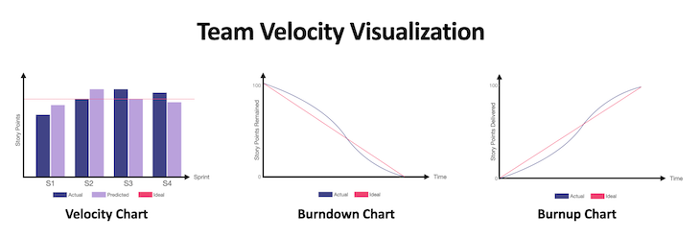
Scrum Artifacts & Practices for Success:
1. Definition of Done (DoD):
A clear and shared understanding of what constitutes "done" for any
Product Backlog item.
2. Burn-Down Chart:
A Burndown Chart is a simple visual tool that shows how much work is left in a Sprint or project. It tracks the remaining work over time and helps the team see if they are on track to meet their goals.
3. Velocity:
Team velocity is the amount of work a team can
complete in a Sprint. It’s usually measured in
story points or similar units. This helps the team
plan how much work they can handle in future Sprints.

Slide 22
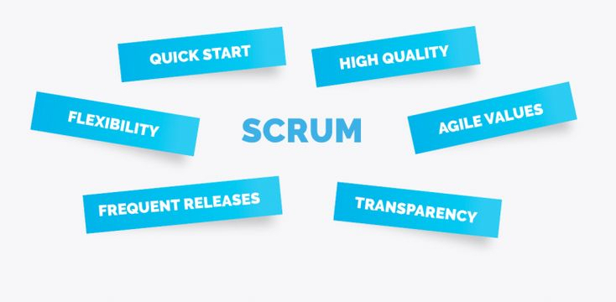
Benefits of Scrum:
Transparency:
Scrum ensures everyone can see the project's progress through
meetings, tools, and regular updates.
Flexibility:
Scrum allows teams to adapt quickly to changes in priorities
or requirements.
Collaboration:
Scrum promotes teamwork and communication between the
Product Owner, Scrum Master, and Development Team.
Improvement:
Scrum encourages learning and improving processes through
Sprint Retrospectives.
Faster Delivery:
Scrum delivers small, working parts of the project at the end of each Sprint, providing value quickly.

Slide 23
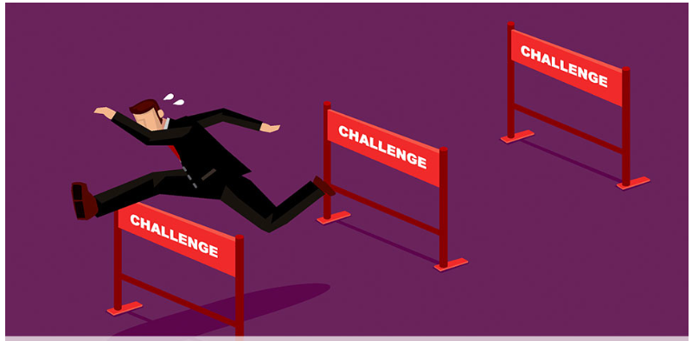
Challenges of Scrum:
Needs Experienced Teams:
Scrum can be difficult for teams new to Agile
or not used to self-management.
Consistency Required:
Scrum only works well if all team members follow
its principles and practices properly.
Risk of Overcommitment:
Teams may plan too much work for a Sprint,
leading to unfinished or rushed tasks.

Slide 24
CRYSTAL

Slide 25
Principles of the Crystal Agile methodology:
Crystal: The Crystal Agile Framework is a flexible software development approach focusing on people,
communication, and collaboration. It adapts to the unique needs of each project based on its size,
complexity, and importance.
Principles:
Frequent Delivery: Regularly deliver tested, working code to ensure it meets user needs.
Reflective Improvement: Continuously assess and improve processes based on past performance.
Osmotic Communication: Keep the team together in one space to naturally share information.
Personal Safety: Create a safe space for open communication and idea sharing without fear.
Focus on Work: Set clear priorities so team members can focus without frequent task switching.
Access to Experts and Users: Ensure developers can interact with real users and experts for valuable feedback.
Technical Environment: Use tools for automated testing, configuration, and continuous integration to detect and fix errors quickly.

Slide 26
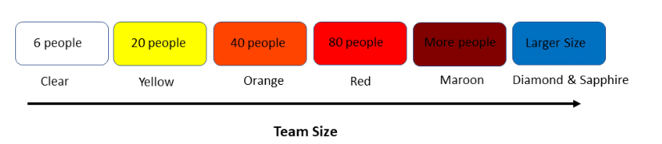
Crystal Family:
The Crystal Family is a set of Agile methodologies designed to fit projects of different sizes, complexities, and risks. Each variation focuses on communication, simplicity, and flexibility while adapting to team and project needs.
1. Crystal Clear:
Minimal processes,
face-to-face communication,
frequent delivery, and little
documentation. Best for small and simple projects.
2. Crystal Yellow: Adds some structure, light documentation, and clear goals for medium-sized teams. Ideal for moderately complex projects.
3. Crystal Orange: Introduces more formal processes and tracking while retaining flexibility. Suitable for medium-to-large projects.
4. Crystal Red: Formal roles, structured processes, and detailed tracking to handle complexity and risk. Designed for large or critical projects.
5. Crystal Blue (and others): Highly formalized structure to manage very large, complex projects while staying flexible.

Slide 27
Strengths, Challenges of Crystal:
Strengths of Crystal:
Flexible: Adapts to different project needs and team dynamics.
Lightweight: Requires minimal documentation and processes.
Team Empowerment: Let teams choose practices that work best for them.
Focus on Communication: Encourages clear and frequent informal communication.
Challenges of Crystal:
Limited Scalability: Works best for small teams; larger teams may need more structure.
Less Guidance: Difficult for Agile beginners as it relies on team experience.
Team Proximity: Designed for co-located teams, so remote work needs adjustments.
When to Use Crystal:
For small to medium-sized teams.
When projects have uncertainty or changing requirements.
For experienced Agile teams that value flexibility.

Slide 28
FEATURE-DRIVEN DEVELOPMENT

Slide 29
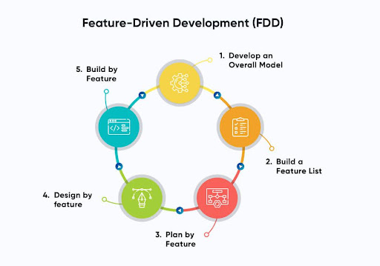
Stages of FDD:
Its an agile software development methodology that focuses on building features incrementally to create a complete product.
1. Develop an Overall Model: The team creates a base object model to
solve the domain problem, serving as the foundation for building
the application and its features.
2. Build the Features List: The team lists all product features based on the
vision and user needs. These features are broken into small tasks that can
be completed in 2–10 days.
3. Plan by Feature: Features are prioritized based on value, resources, time,
risks, and dependencies. Each feature is assigned to specific teams
called "feature owners."
4. Design by Feature: High-priority features are detailed, designed,
and reviewed. This step refines both the feature and the overall model.
5. Build by Feature: Development, testing, and integration of features take place.
Completed features are reviewed, added to the main product, and made available for client use.

Slide 30
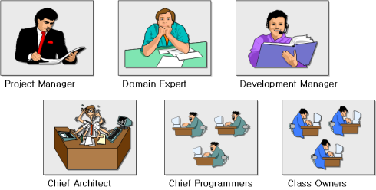
FDD Team Roles:
Role | Responsibilities
Chief Architect | Oversees technical direction and system design; guides the team on technical challenges.
Chief Programmer | Leads the development team; ensures features are implemented and the project is successful.
Feature Owners | Responsible for the successful delivery of specific features; works with the team to define and deliver.
Class Owners | Developers in charge of specific classes or components; handle coding and related documentation.
Domain Expert | Provides deep knowledge of the problem domain; ensures the system meets business needs.
Project Manager | Tracks project progress, manages schedules, resources, and communication to achieve project goals.

Slide 31
FDD vs. Scrum:
Aspect | FDD | Scrum
User Involvement | Involves actual product users in development | The Product Owner acts as the end user
Focus Areas | Emphasizes domain modeling and design | Does not focus on domain-driven design
Timeline | Features are developed in 2–10 days | Sprints last 2–4 weeks
Team Structure | Complex structure with roles like Chief Programmer and Domain Expert | Lean structure with roles like Scrum Master and Product Owner
Documentation | Values detailed documentation | Prefers daily stand-ups and frequent meetings

Slide 32
Advantages & Disadvantages of FDD:
Advantages of FDD
Involves real end-users, leading to user-focused product development.
Domain modeling and planning provide a clear and predictable roadmap.
Scalable for large and complex projects due to its structured approach.
Strong documentation improves visibility, productivity, and efficiency.
Breaking tasks into smaller parts makes code management easier.
Disadvantages of FDD
Complex team structure is not ideal for small projects.
Team building and training require extra time and budget.
Dependencies between features can delay the development process.
Limited flexibility for ongoing feature changes due to upfront planning.

Slide 33
When to Use FDD:
For large projects with multiple teams.
When project requirements are well-defined.
For organizations needing structured Agile methods with clear goals.

Slide 34
ADAPTIVE SOFTWARE DEVELOPMENT

Slide 35
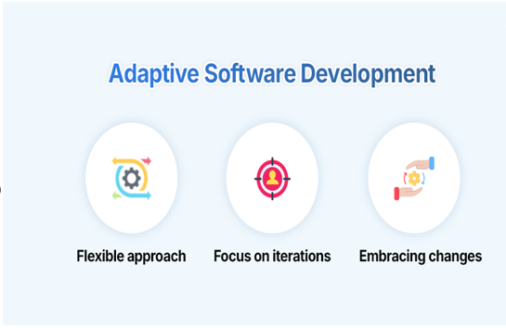
Key Principles of Adaptive Software Development (ASD):
Adaptive Software Development (ASD) is an Agile approach created by Jim Highsmith. It focuses on flexibility, collaboration, and continuous learning to handle complex and uncertain projects.
1. Collaborative Development
Teamwork is key! Developers, testers, and business reps work
closely together.
Frequent communication ensures quick adjustments and
problem-solving.
2. Iterative & Incremental Process
Software is built in small steps, improving with each iteration.
Unlike Scrum, ASD allows flexible iteration lengths based on
project needs.

Slide 36
3. Continuous Adaptation
Change is good! ASD embraces evolving requirements.
Regular adjustments help improve the product and process
4. Feedback-Driven Development
Constant feedback from users and stakeholders shapes the product.
Frequent reviews ensure the software aligns with business goals.
5. Risk Management
Address high-risk areas early with prototypes or proof-of-concept builds.
Identifying issues early helps reduce bigger problems later.
6. Embracing Uncertainty
Software development is unpredictable—ASD adapts rather than resists change.
Teams learn and improve continuously to refine their solutions.

Slide 37
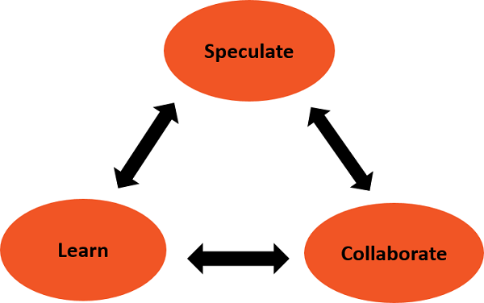
Three Phases of Adaptive Software Development:
1. Speculation
Set initial project goals and requirements.
Identify risks and prepare for flexibility.
No fixed plan—assumptions may change as the project evolves.
2. Collaboration
Team members, users, and stakeholders work together.
Sharing knowledge and ideas ensures alignment.
Continuous adjustments improve the product.
3. Learning
Gather feedback from users and stakeholders.
Refine and improve the product with each iteration.
Lessons learned guide the next development steps

Slide 38
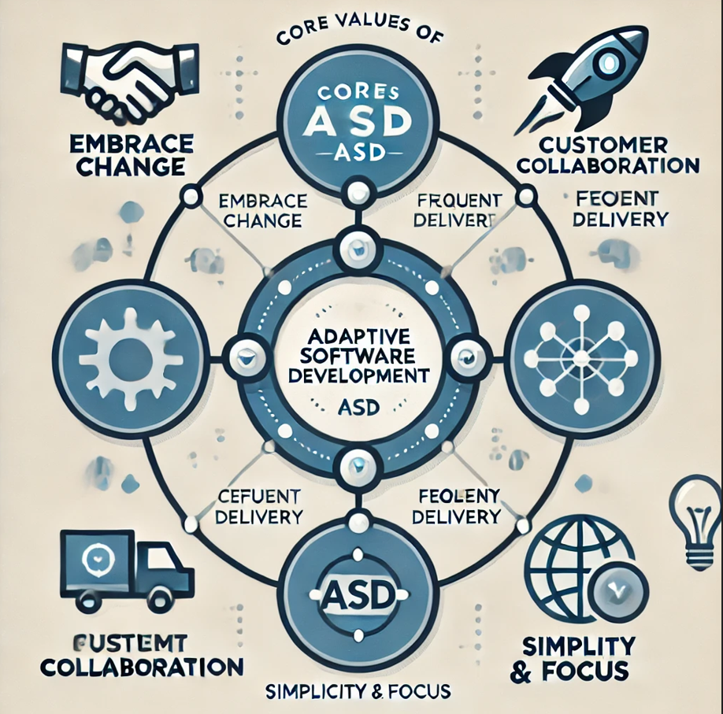
Core Values of ASD:
1. Embrace Change
Change is a natural part of development.
Flexibility helps teams adapt to new requirements.
2. Customer Collaboration
Customers and stakeholders are involved at every stage.
Their feedback helps shape the product.
3. Frequent Delivery
Working software is released regularly.
Early and continuous delivery provides value.
4. Simplicity & Focus
Keep solutions simple and avoid unnecessary complexity.
Deliver just enough functionality with room for adjustments.

Slide 39
ASD vs. Other Agile Methodologies:
Aspect | ASD | Scrum | Kanban | Crystal
Structure | Flexible, adapts to project needs | Structured with fixed-length Sprints & defined roles | Visual workflow management (Kanban board) | Adjusts processes based on team size & complexity
Iterations | Varies based on project needs | Time-boxed Sprints | Continuous flow, no fixed iterations | Different "colors" for different projects
Focus | Adapting to change, continuous learning | Following a structured Agile process | Optimizing workflow & limiting WIP | Scaling Agile based on project needs
Roles & Processes | Encourages collaboration, but no strict roles | Defined roles (Scrum Master, Product Owner, Dev Team) | No prescribed roles, self-managed teams | Customizable based on project complexity
Key Features | Speculation, Collaboration, Learning | Sprint Planning, Daily Standups, Retrospectives | Visualizing work, improving efficiency | Different approaches for different team sizes

Slide 40
When to Use ASD, Advantages & Challenges:
📌 When to Use ASD:
✅ Uncertain & Complex Projects – Requirements may change over time. ✅ High-Risk & Innovative Projects – Helps manage unknowns and evolving needs. ✅ Large Teams – Collaboration & feedback help navigate complexity.
✅ Advantages of ASD:
✔ Flexibility – Adapts to changing requirements. ✔ Customer Satisfaction – Frequent feedback ensures alignment. ✔ Team Empowerment – Encourages creativity & shared ownership. ✔ Continuous Improvement – Focus on learning & refinement.
⚠️ Challenges of ASD:
⚡ High Collaboration Needs – Requires strong communication & trust. ⚡ Ambiguity in Planning – Less structured than traditional methods. ⚡ Complex Implementation – Teams need experience to balance adaptability & structure.

Slide 41
Extreme Programming (XP)

Slide 42
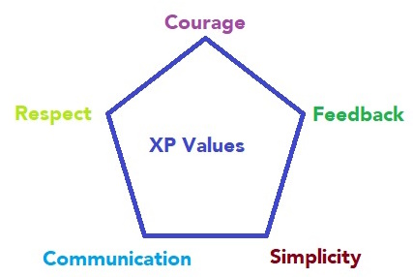
Core Principles of Extreme Programming (XP):
Extreme Programming (XP) is an Agile methodology that ensures high-quality software through engineering practices, frequent releases, and strong team collaboration to quickly adapt to changing requirements.
Core Principles:
✅ Communication – Open and direct collaboration among
developers, customers, and stakeholders. ✅ Simplicity – Build only what is needed, avoiding unnecessary
complexity. ✅ Feedback – Continuously improve through testing, customer input,
and team insights. ✅ Courage – Make bold decisions, adapt plans, and refine code
when needed. ✅ Respect – Value every team member’s contribution and maintain
a supportive environment.

Slide 43
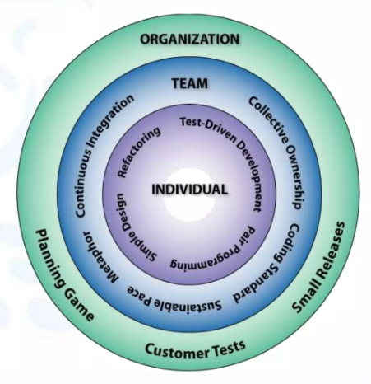
Key Practices of Extreme Programming (XP):
✅ Test-Driven Development (TDD) –
Write tests before coding to ensure correct functionality. ✅ Pair Programming –
Two developers code together to improve quality and share knowledge. ✅ Continuous Integration –
Frequently merge and test code to catch issues early. ✅ Refactoring –
Continuously improve code structure without changing functionality. ✅ Small Releases –
Deliver small, functional updates frequently for quick feedback. ✅ Collective Code Ownership –
The whole team shares responsibility for the codebase. ✅ Coding Standards –
Follow consistent guidelines for clean, readable code. ✅ Sustainable Pace – Maintain a steady, manageable workload to avoid burnout. ✅ On-Site Customer – Have a customer available for immediate feedback. ✅ Metaphor – Use simple, shared language to describe the system’s design.

Slide 44
Benefits & Challenges of Extreme Programming (XP):
Benefits of XP:
✅ High Quality – TDD and pair programming improve code reliability. ✅ Flexibility – Easily adapts to changing requirements. ✅ Faster Feedback – Frequent releases and testing provide quick insights. ✅ Team Collaboration – Encourages teamwork and knowledge sharing. ✅ Customer Satisfaction – Continuous customer involvement ensures the right product.
Challenges of XP:
⚠ Steep Learning Curve – Requires time to master TDD and pair programming. ⚠ Team Dependency – Success relies on skilled and committed team members. ⚠ Customer Availability – Needs frequent customer feedback, which may be difficult. ⚠ Scaling Issues – Challenging for large or distributed teams.

Slide 45
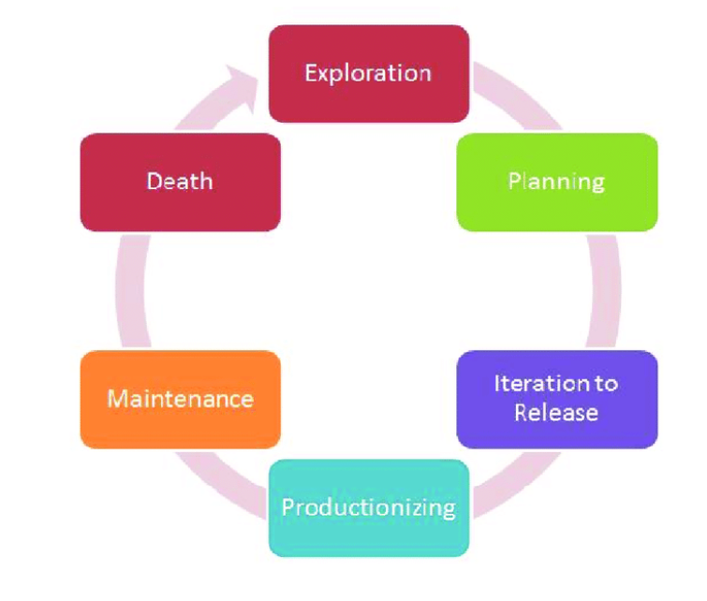
Lifecycle of Extreme Programming (XP):
XP follows short, iterative cycles to adapt to changing requirements.
1. Exploration Phase – Understand customer needs. ✔ Define user stories with customers. ✔ Check technical feasibility.
2. Planning Phase – Prioritize and plan tasks. ✔ Break user stories into small tasks. ✔ Estimate effort and select tasks for development.
3. Iteration to Release – Develop and test. ✔ Code using pair programming. ✔ Validate with test-driven development (TDD). ✔ Frequently integrate and test.
4. Productionizing Phase – Prepare for release. ✔ Conduct final system testing. ✔ Deliver product increment to the customer.
5. Maintenance Phase – Improve and update. ✔ Fix bugs and respond to feedback. ✔ Continue development with XP practices.
6. Death Phase – Project completion. ✔ Deliver the final product. ✔ Review and learn for future projects.

Slide 46
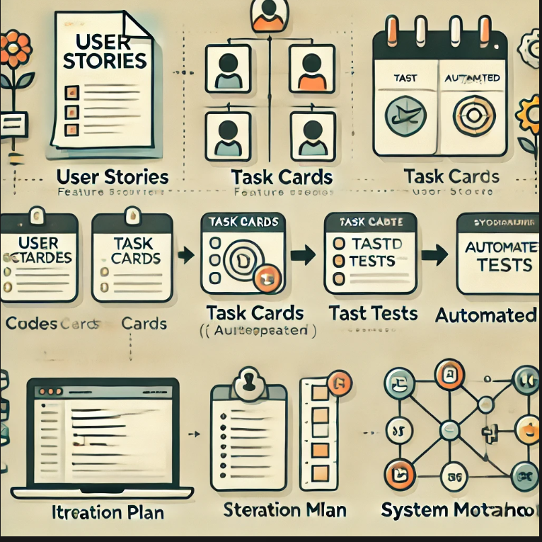
Work Products in XP:
XP produces lightweight documents to keep development agile and clear.
User Stories – Short descriptions of features from the customer’s perspective.
Task Cards – Small tasks derived from user stories for easy tracking.
Codebase – The evolving software, following strict coding standards.
Automated Tests – Unit and acceptance tests to ensure functionality.
Iteration Plan – A simple plan outlining tasks for the current cycle.
System Metaphor – A shared concept that explains the system’s
structure.

Slide 47
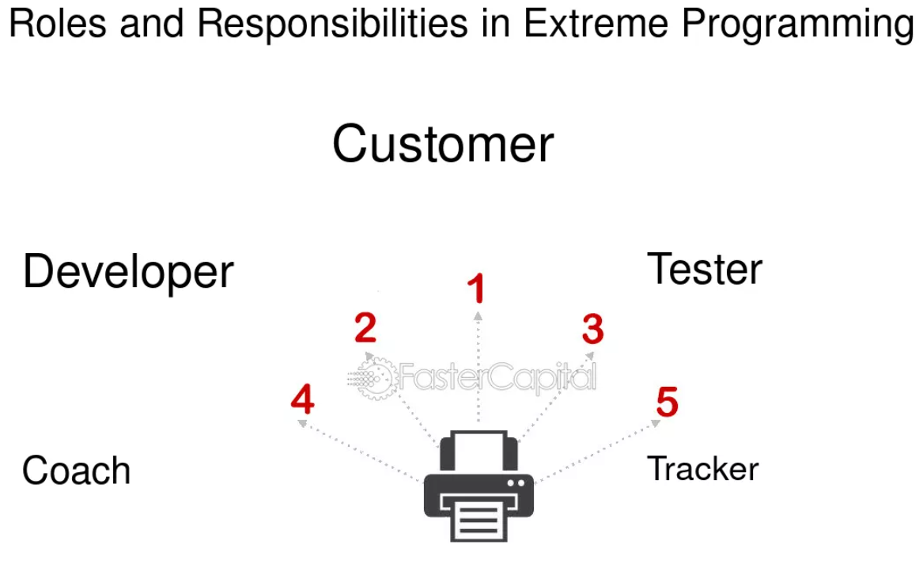
Roles in XP:
XP teams work collaboratively, with specific roles for efficiency.
🔹 Primary Roles: ✔ Customer – Provides user stories and feedback. ✔ Developers – Write and test code using XP practices. ✔ Tester – Creates and runs automated tests. ✔ Tracker – Monitors progress and team commitments. ✔ Coach – Ensures XP principles are followed.
🔹 Secondary Roles: ✔ Manager – Handles resources and external communication. ✔ Domain Expert – Provides specialized knowledge.

Slide 48
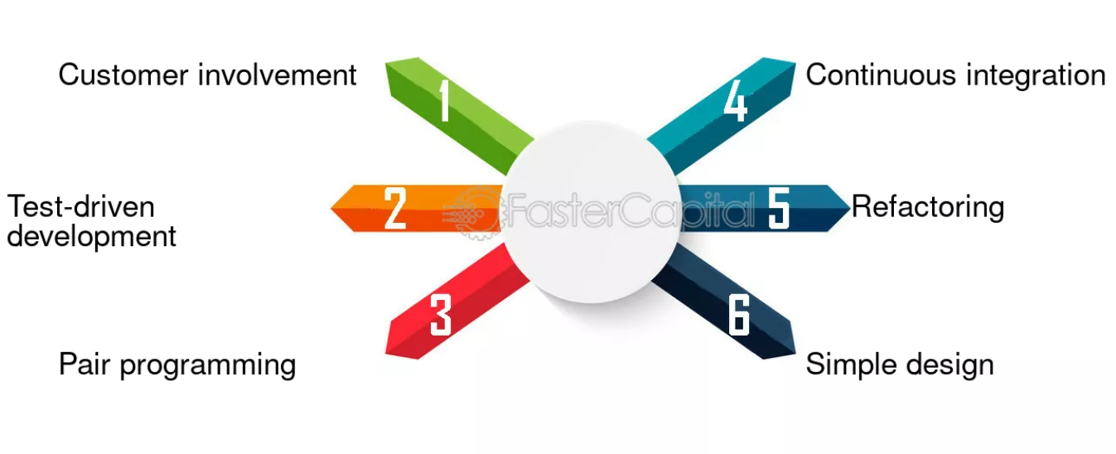
Implementation of XP in the Project:
Pair Programming –
Two developers worked together to write, review, and debug code.
2. Test-Driven Development (TDD) –
Tests were written before coding to ensure correctness.
3. Frequent Releases –
Working software was delivered every two weeks.
4. Continuous Integration – Automated builds and tests prevented issues with new code.
5. On-Site Customer – A client representative provided real-time feedback.
6. Simplicity – Only essential features were designed and implemented.
7. Refactoring – Code was continuously improved without changing functionality

Slide 49
Project Outcome & Key Lessons Learned:
Deliverables:
A fully functional CRM system was delivered on time and within budget.
Key features included customer data management, analytics dashboards, and automated marketing tools.
Client Feedback:
The client was highly satisfied and appreciated the collaborative approach.
Metrics:
Defect rate reduced by 30% compared to previous projects.
Development time decreased by 20% due to better planning and teamwork.
Training is Important: Teams need proper training in XP practices like TDD and pair programming.
Client Commitment: An on-site customer helps, but their active participation is crucial.
Balance Simplicity & Complexity: Build simple solutions but plan for long-term needs.
Tailoring XP: Adjust XP practices to fit the team and project needs.

Slide 50
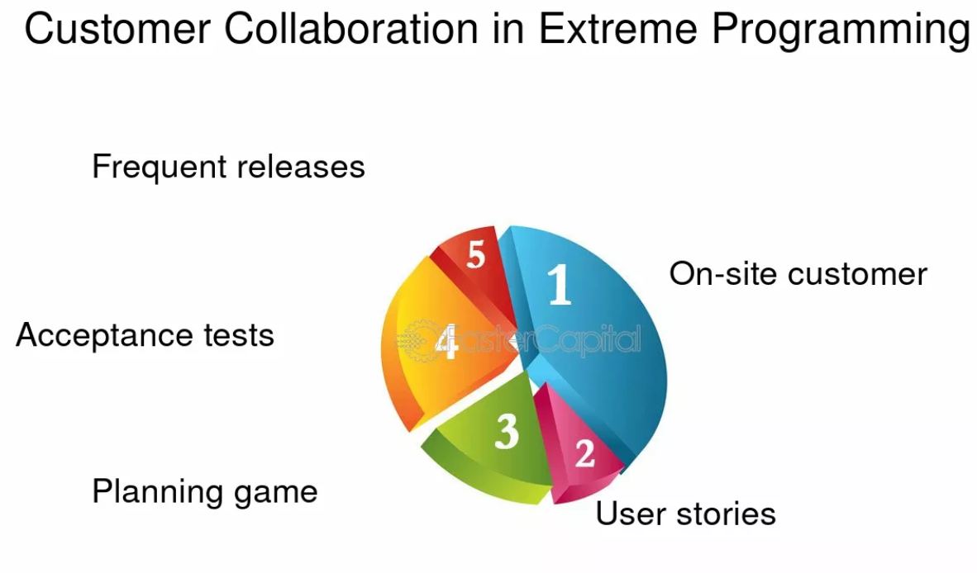
When to Use XP:
When to Use XP:
✔ For projects with frequent changes. ✔ Teams that focus on high-quality code. ✔ When customer involvement is high. ✔ Best for small to medium-sized teams.
Conclusion:
XP improves software development by enhancing collaboration, flexibility, and customer focus. Its success depends on team commitment, client involvement, and adapting to changing requirements. When implemented well, XP leads to high-quality software, satisfied customers, and an empowered team.

Slide 51

This Photo by Unknown Author is licensed under CC BY-SA-NC

